Slide 1


Bad Credit Prevention
Nguyen Hoang Minh linkedin.com/in/minhhoangnguyen123/
Last Updated: 23 Jun 2023

Slide 2

Table of Contents
Objective
Analysis
Machine Learning
Conclusion
Appendix

Slide 3

Objective
What we are looking for

Slide 4



Objective
What does a Poor credit scorer look like?
What can we do to avoid low credit scoring customers?

Slide 5

Analysis
What we found

Slide 6
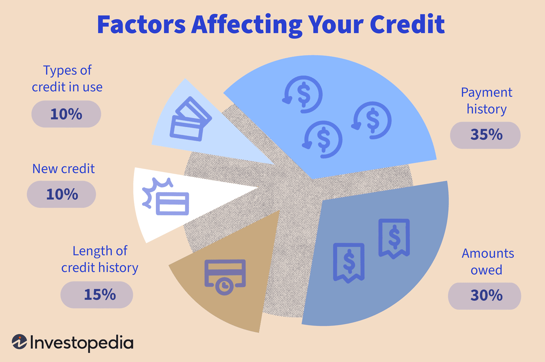
FICO Score 8
Late Payment
Loans Amount & Types
Credit Age
Payment Behavior
Income
Age
https://www.investopedia.com/articles/pf/10/credit-score-factors.asp

Slide 7
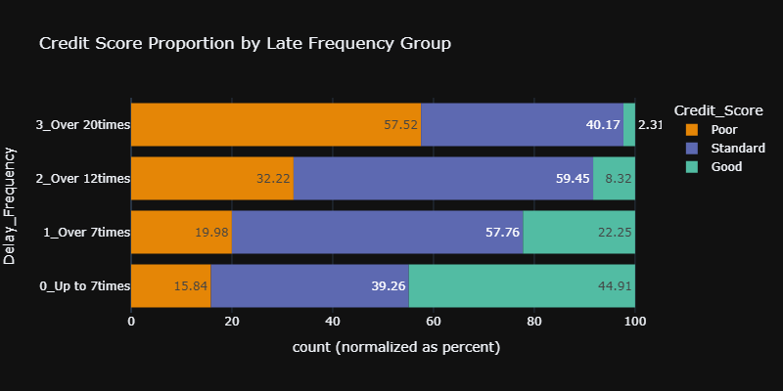
Late Frequency
Negative Correlation between Credit Score and late debt payment.
Poor scorer increase when late over 12 times.
→ Auto-pay, change due date and refinance.

Slide 8
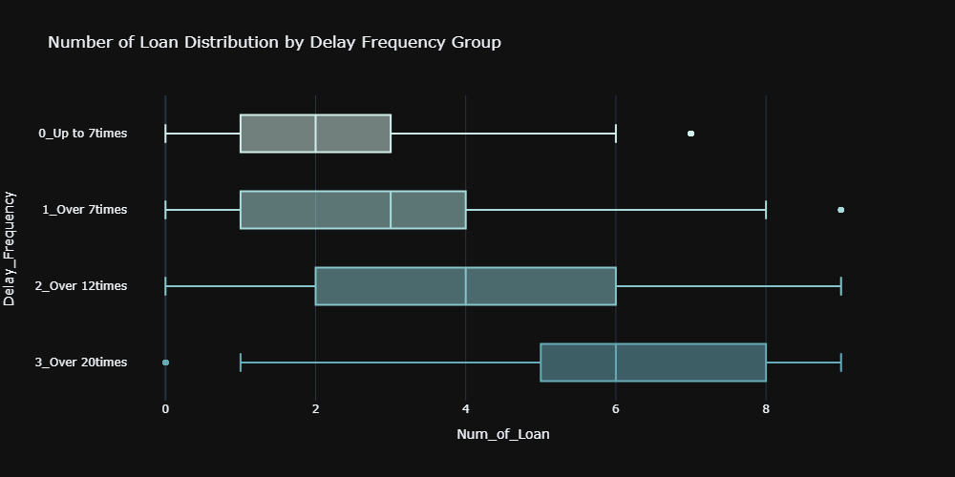
Late Frequency
More loans means more late payment.
Late payment is dependent on number of loans.

Slide 9
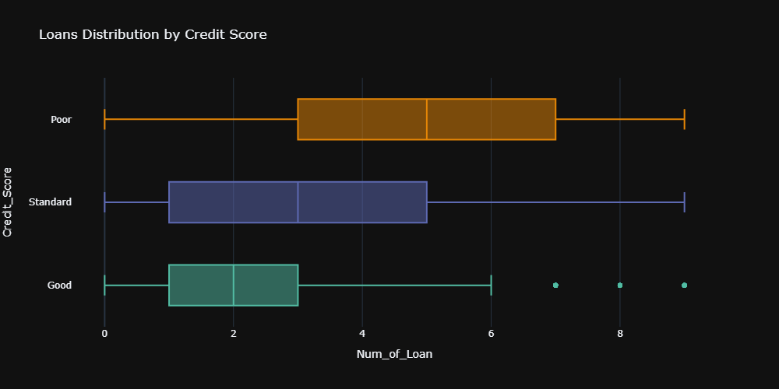
Loans
Large number of loans correlates with lower Credit Scores.
Risk in ability to pay and on time.
→ No more than around 3 loans.

Slide 10
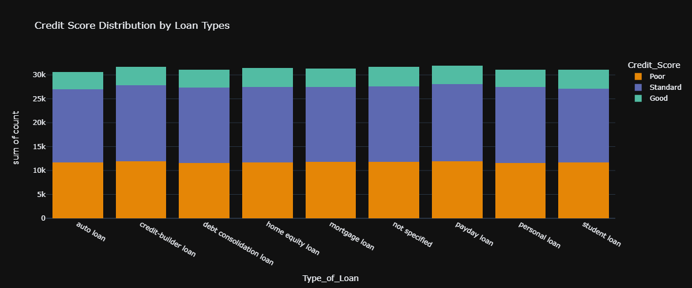
Loan Types
No correlation between Loan types and Credit Score.
E.g., Personal loans are usually unsecured.

Slide 11
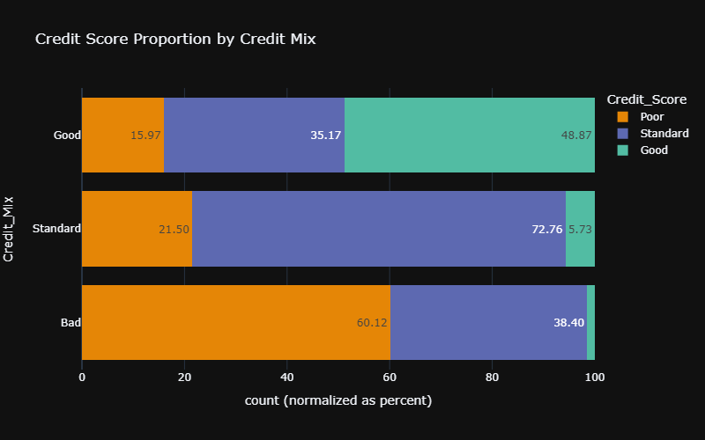
Credit Mix
Greater Credit Mix are like to have better Scores.
Shows ability to manage different accounts.
→ Incentivize loans for different purposes (e.g., business loan discount for high value mortgage).

Slide 12
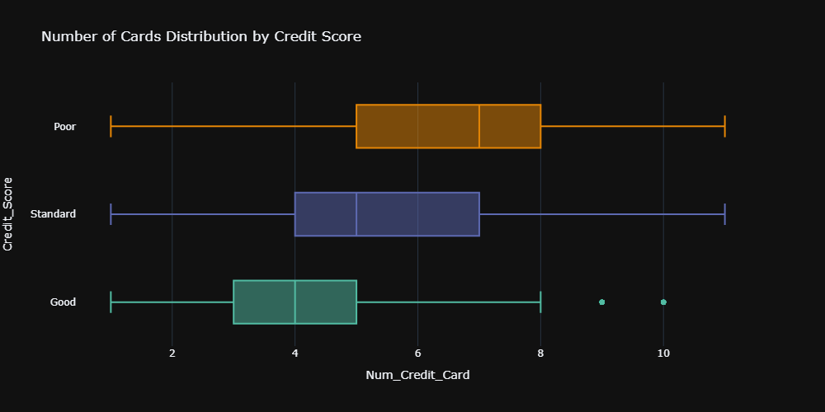
Credit Accounts
More credit accounts results in low Credit Scores.
Hard to manage and keep track of due dates.
→ Less than 5 credit accounts.

Slide 13
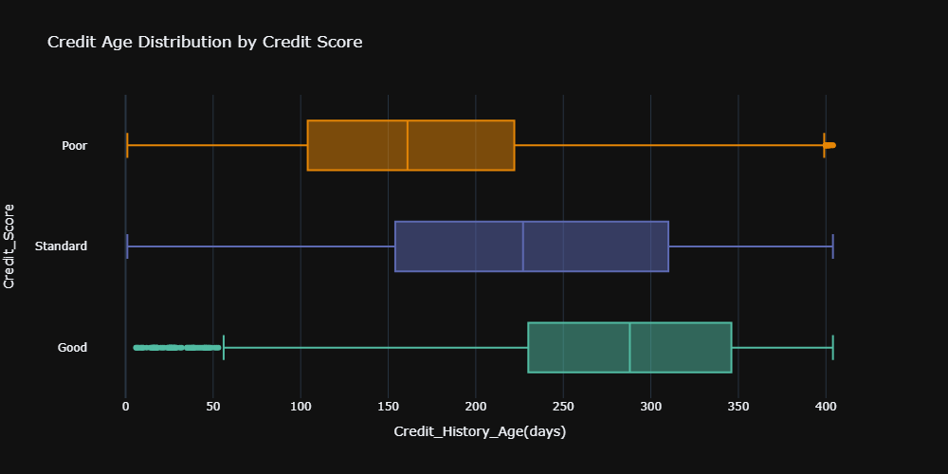
Credit Age
Longer Credit History allows Higher Credit Score.
Larger information on credit user.

Slide 14
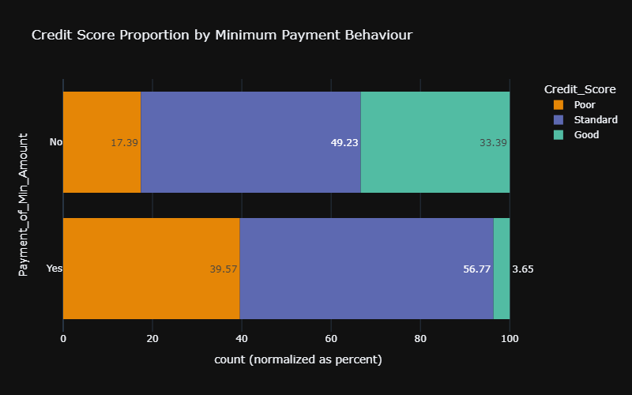
Minimum Payment Behaviors
Paying the minimum amount signify low Credit Score.
This should not affect score.

Slide 15
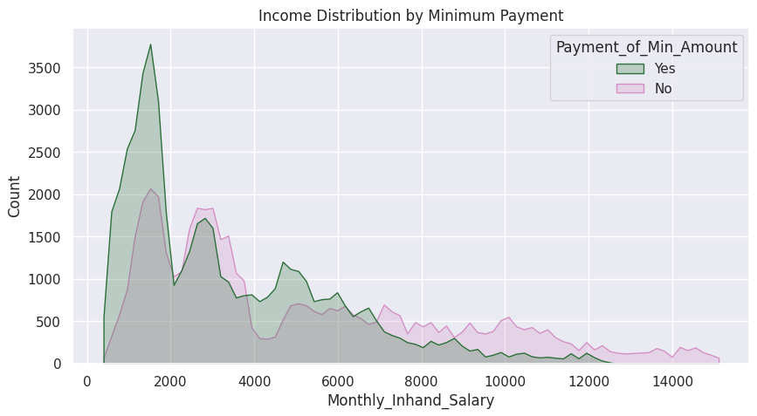
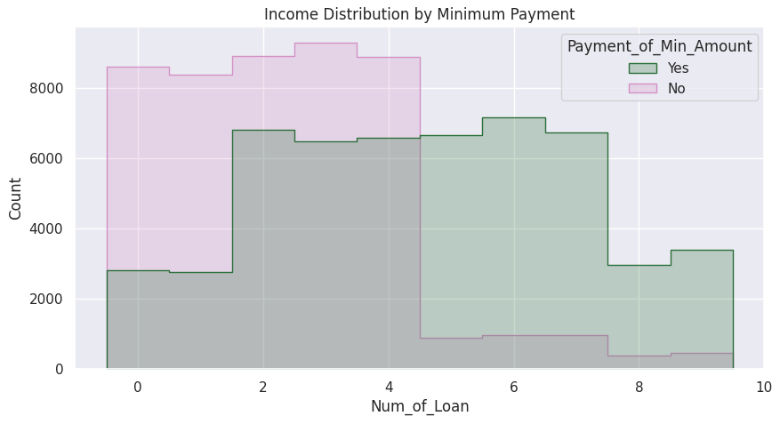
Minimum Payment Behaviors
Minimum payment is an indicator for lower income and higher debt.

Slide 16
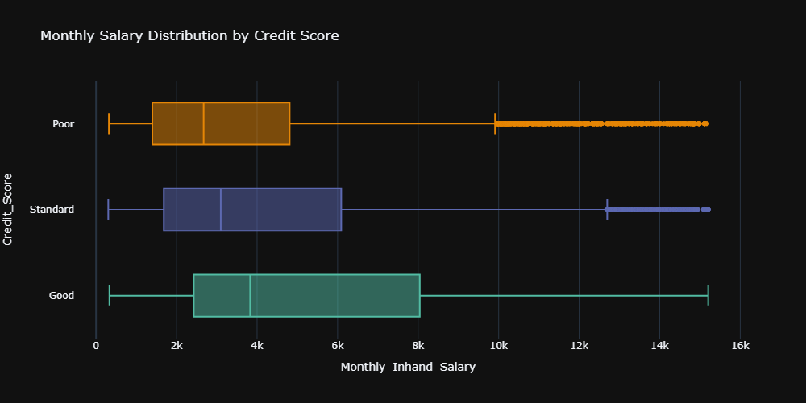
Income
Positive correlation between Income and Credit Score.
Higher income allows more debt and better financial management.

Slide 17
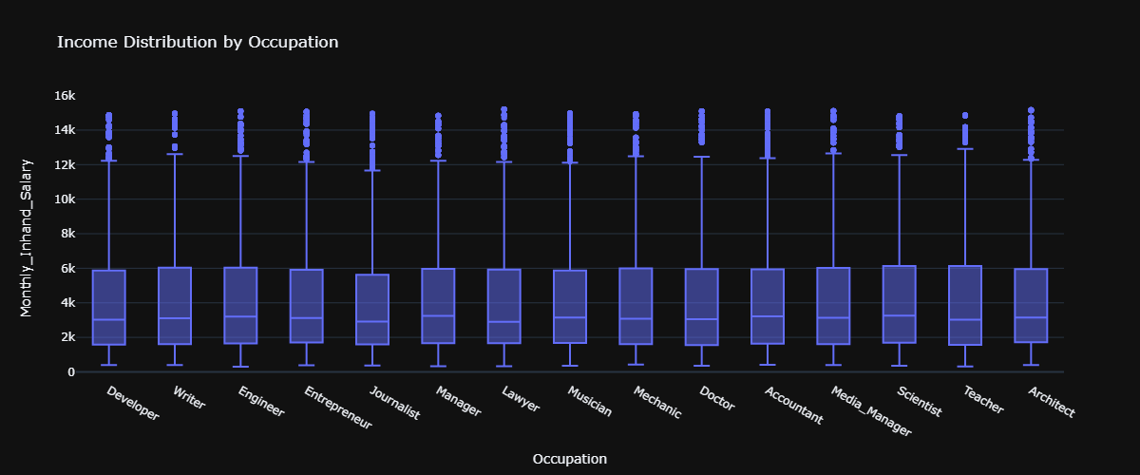
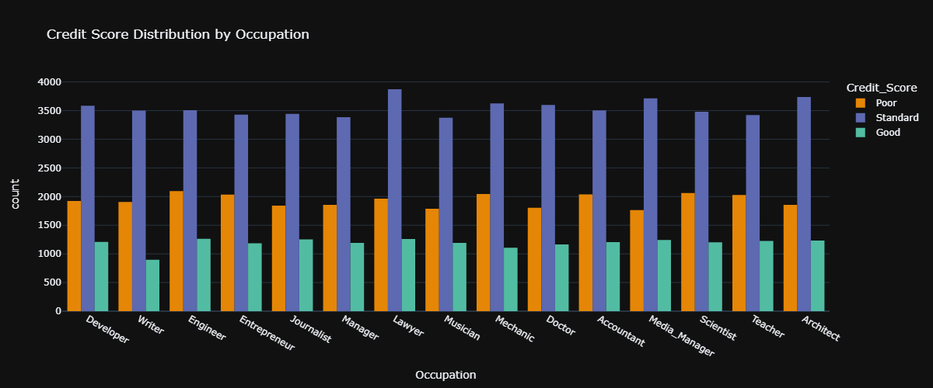
Occupation
Income are even across jobs (no bias).
Occupation has no effect on Credit Score.

Slide 18
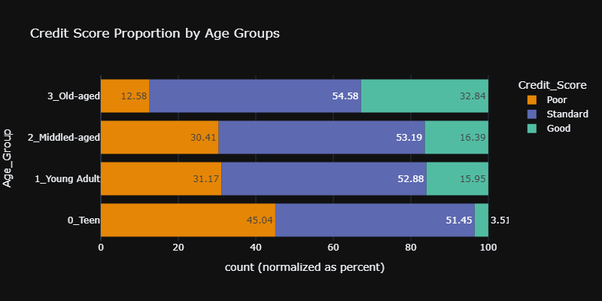
Age
Positive correlation between Age and Credit Score.
Does age explain Credit Score?

Slide 19
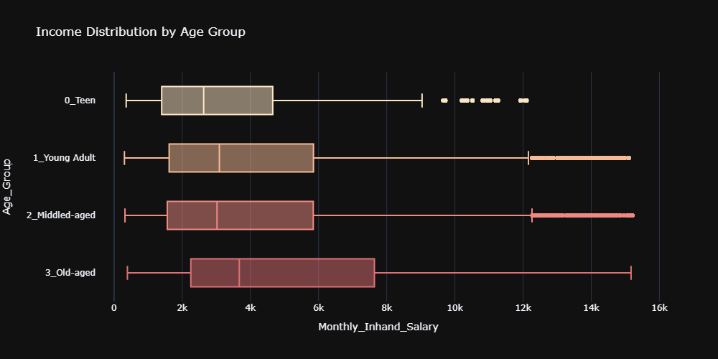
Age
Positive correlation between Age and Income.
Older people have higher positions in their career.

Slide 20
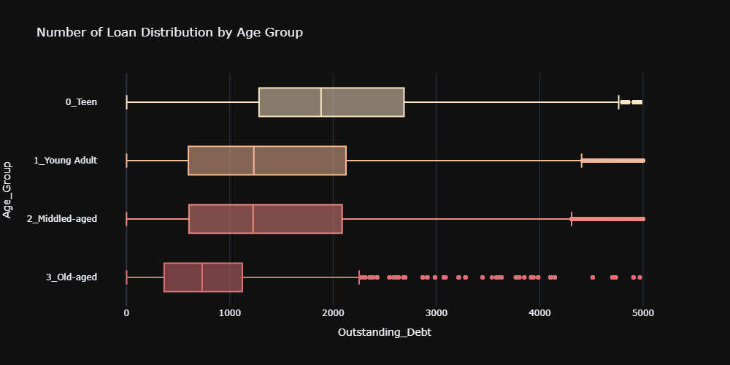
Age
Negative correlation between Age and Debt.
Working-age is from 15-64.

Slide 21
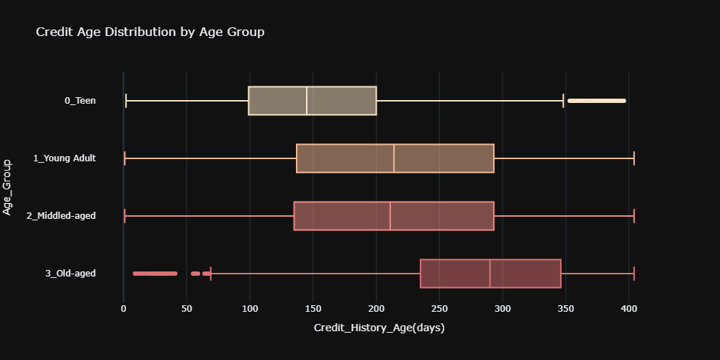
Age
Longer you’ve lived, longer Credit history you have.
Age indirectly influence Credit Score.
→ Cooperate with top universities to educate young customers.

Slide 22

Conclusion
What we have learned

Slide 23

Conclusion
Low Credit Scorers tends to be late for their payment due to holding too many loans.
They don’t manage different type of loans. Or managing too many credit accounts.
They have new accounts with short history.
Younger people inherently are poorer, has short credit history and is holding more debts.
Therefore, they tends to have lower credit scores.

Slide 24
Recommendation
Late frequency 7 times Auto-pay, change due date and refinance.
Loans 3 loans Disallow taking more loans.
Credit Mix Incentivize loans for different purposes (e.g., business loan discount for high value mortgage).
Credit cards 5 accounts Disallow opening new credit accounts.
Credit Age
Cooperate with top universities to educate young customers.
Welcoming bonuses for opening accounts (e.g., cashback, points…).

Slide 25

Machine Learning
Predicting Credit Scores

Slide 26
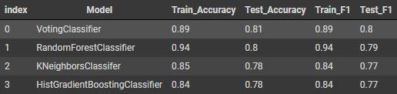
Model

Slide 27
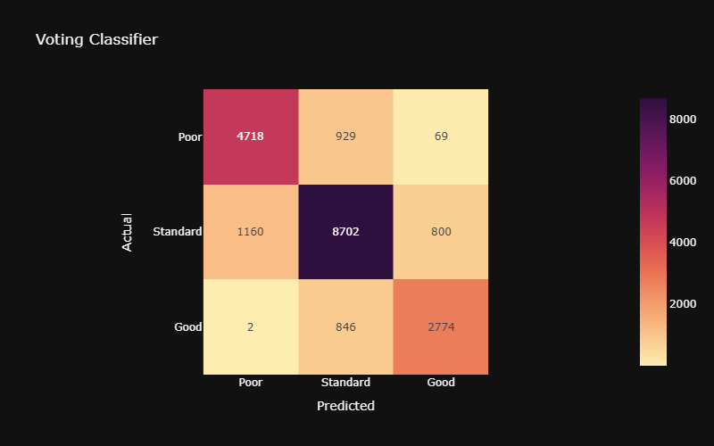
Confusion Matrix
Precision = 0.80 Recall = 0.83

Slide 28
Thank You!
Bad Credit Prevention
Last Updated: 23 Jun 2023
Nguyen Hoang Minh linkedin.com/in/minhhoangnguyen123/

Slide 29

Appendix
Other findings

Slide 30
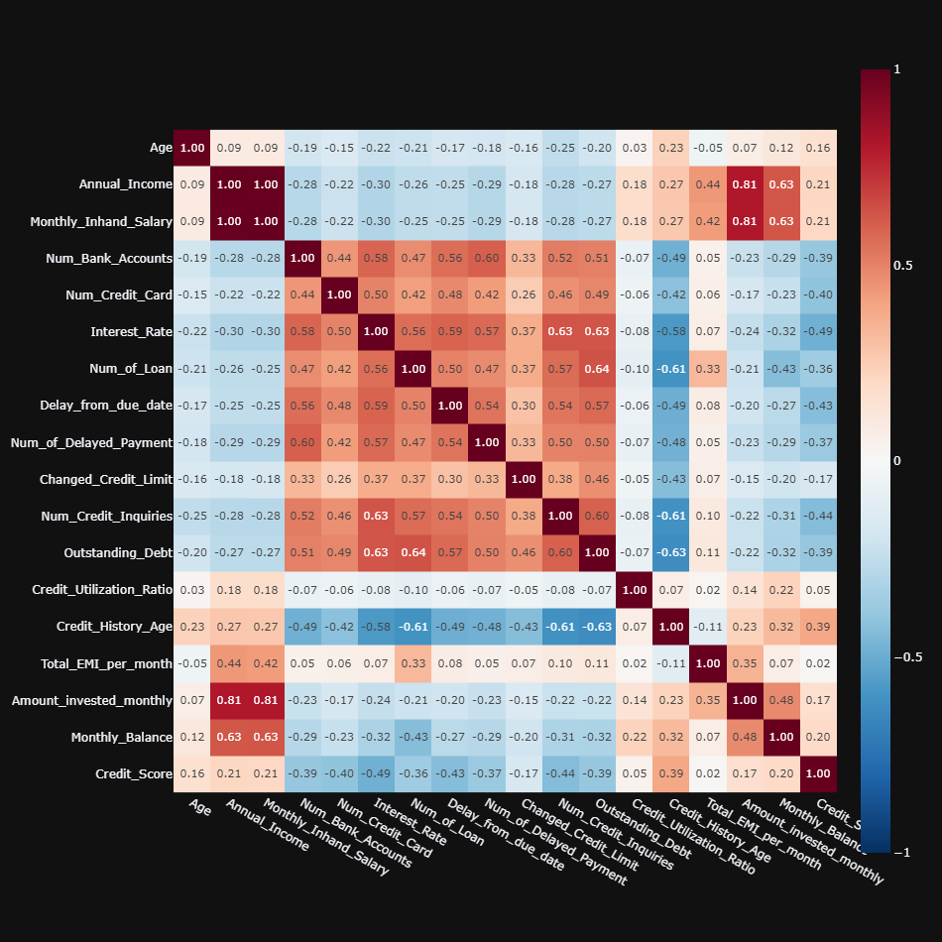
Features HeatMap

Slide 31
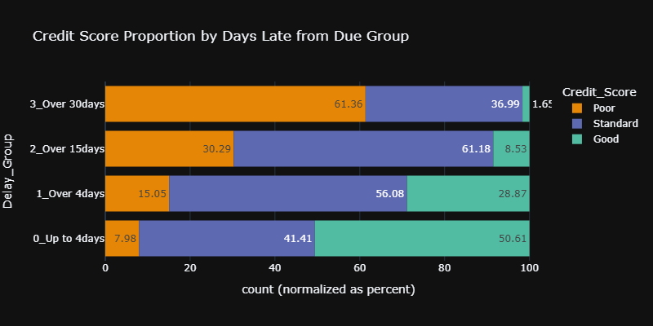
Late Payment
Negative Correlation between Credit Score and late debt payment.
Chance for lower Credit Score doubled after 30 days late.

Slide 32
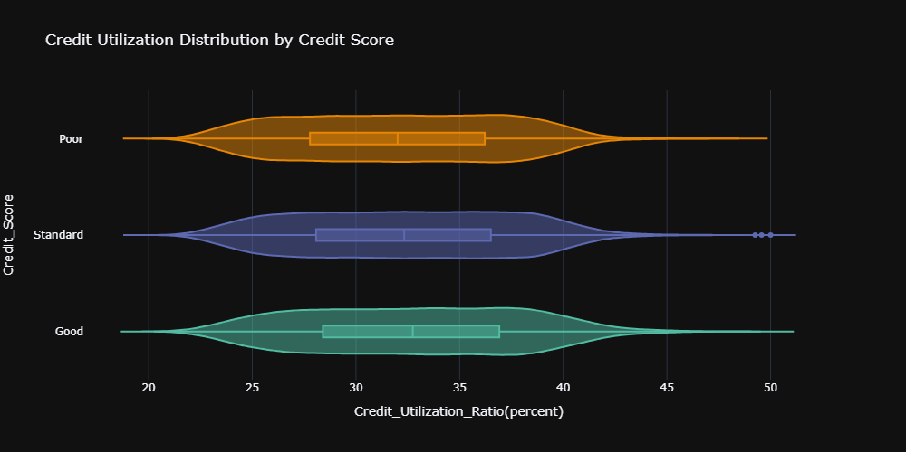
Credit Usage
No visible effect on Credit Score by Utilization ratio.
This Bank does not place importance on utilization.

Slide 33
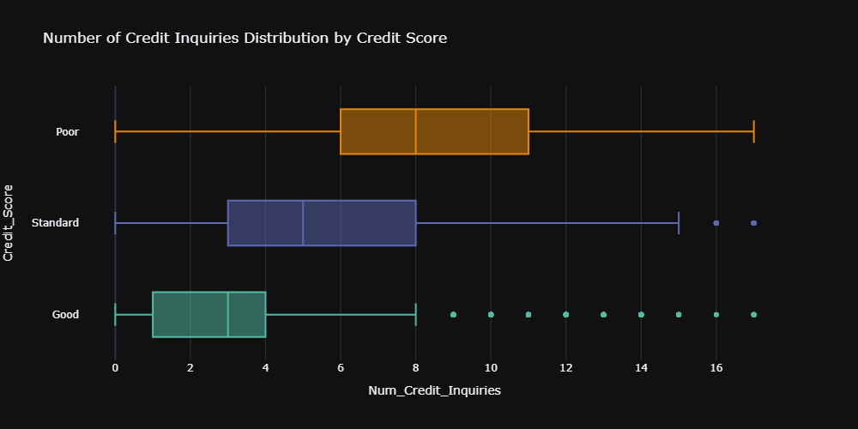
Credit Inquiries

Slide 34
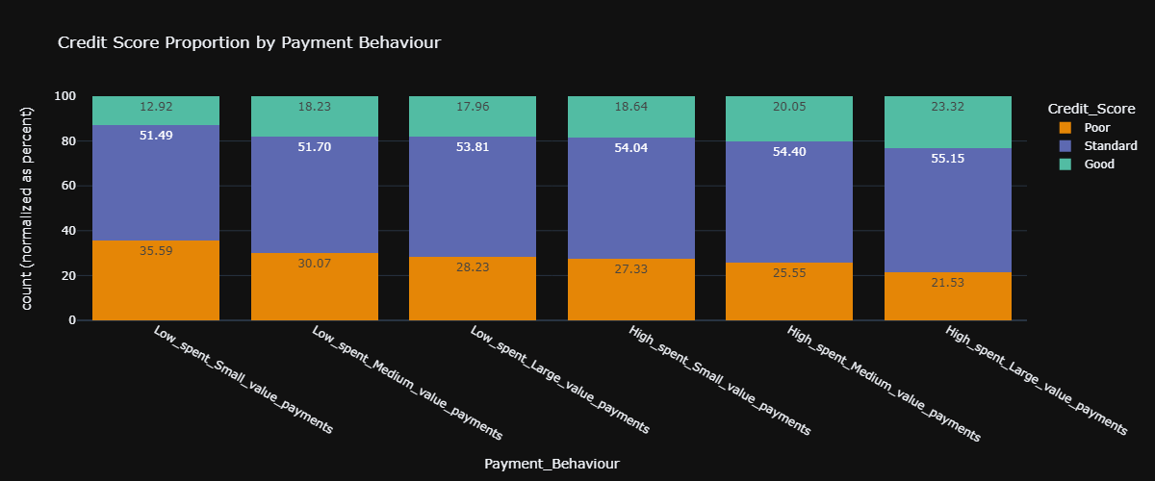
Payment Behaviours

Slide 35
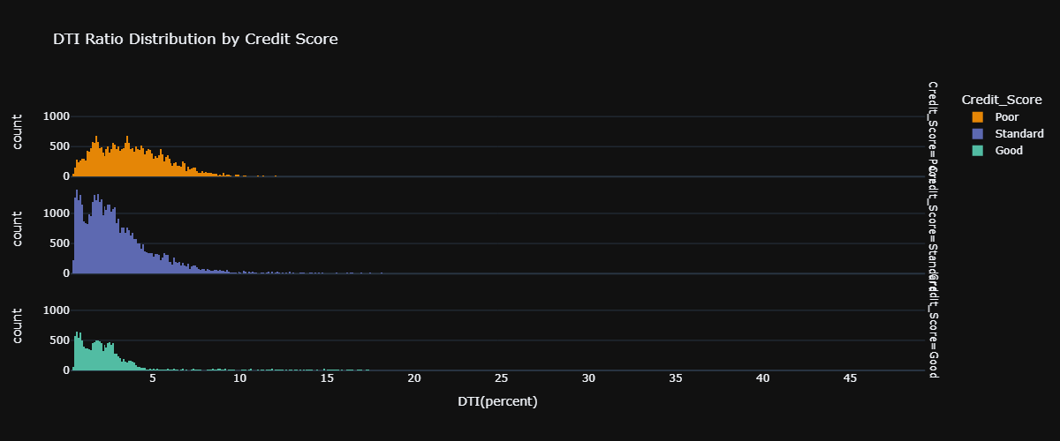
Debt to Income Ratio

Slide 36
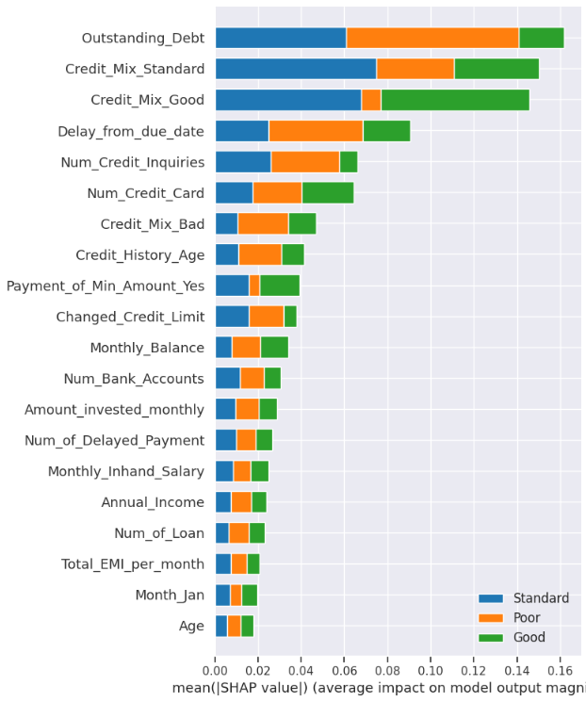
Features Importance
SHAP values as feature importance.
Credit Score is explained by Debt, Credit Mix and Late Payment mostly.
* SHAP assume features are independent, and it explains the feature importance to the model not to the real world.

Slide 37
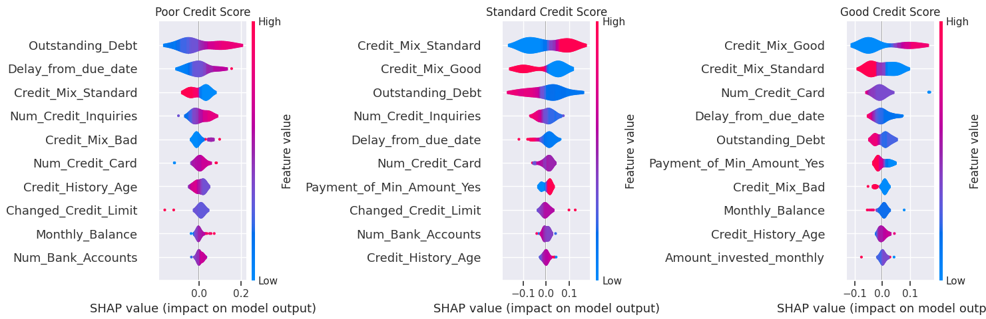
Features Importance by Class

